Slide 1

INFO 7225 Module 2
Managerial Accounting
(7. Budgeting)
Professor Shiaoming Shi
College of Engineering
Northeastern University

Slide 2
Learning objectives
After completing this session, you should be able to
Describe how and why managers prepare and use budgets;
Understand the basic process companies use to create budgets and the general composition of basic budgets that are summed up in a master budget;
Prepare operating budgets;
Prepare financial budgets;
Develop a standard cost;
Compute and evaluate materials variances.

Slide 3
Reading Assignments
Read chapter 7, sections 1 2, and 5
Think about the following questions as you read chapter 7:
What are the advantages to budgeting?
What are the differences between top-down and bottom-up approach to budgeting?
What are the differences between traditional budgeting process and zero-based budgeting process?
What are the differences between a static budget and a flexible budget?
How are operating budgets and financial budgets related within a master budget?

Slide 4
Reading Assignments
Read chapter 8, sections 1, 2 and 5
Think about the following questions as you read chapter 8:
What two components are needed to determine a standard for materials?
What two components are needed to determine a standard for labor?
What elements require consideration before establishing an overhead standard?
What causes a favorable variance and an unfavorable variance?
When might a favorable variance not be a good outcome?
When might an unfavorable variance be a good outcome?

Slide 5
Introduction
The master budget has two major categories:
The operating budget assists in planning and monitoring the day-to-day activities of the organization by informing management of
How many units need to be produced
When and how much material needs to be ordered
How many labor hours need to be scheduled, and
The amount of overhead expected to be incurred
The financial budget assists with planning and monitoring the financing requirements of the organization
Notes:
The master budget has two major categories: the financial budget and the operating budget.
The financial budget plans the use of assets and liabilities and results in a projected balance sheet.
The operating budget helps plan future revenue and expenses and results in a projected income statement.
The operating budget has several subsidiary budgets that all begin with projected sales.

Slide 6
Introduction
The operating budget helps plan future revenue and expenses and results in a projected _______________.
The financial budget plans the use of assets and liabilities and results in a projected _______________.
The operating budget has several subsidiary budgets that all begin with _______________.

Slide 7
Operating Budgets, Financial Budgets, and the Relationship between Budgets
Notes:
Figure 7.6 Operating Budgets, Financial Budgets, and the Relationship between Budgets.

Slide 8
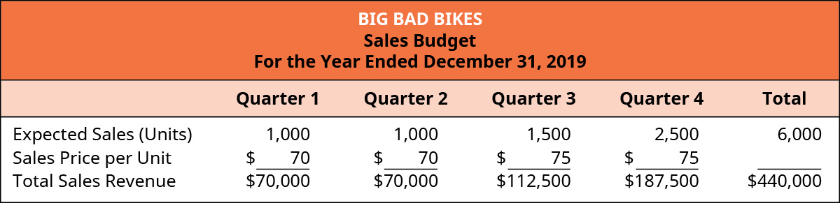
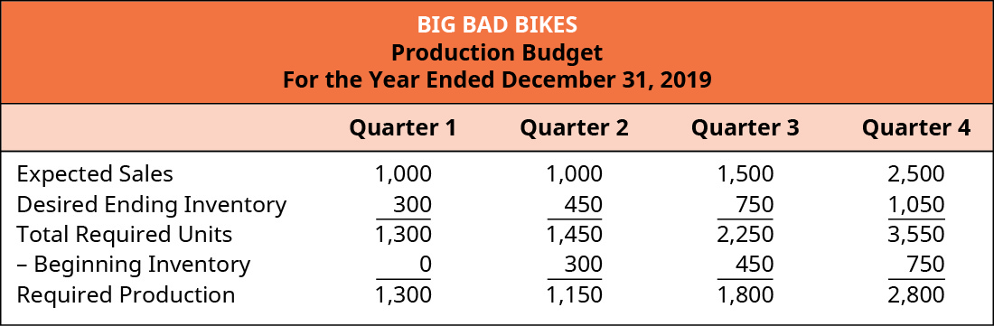
Prepare Operating Budgets

Slide 9
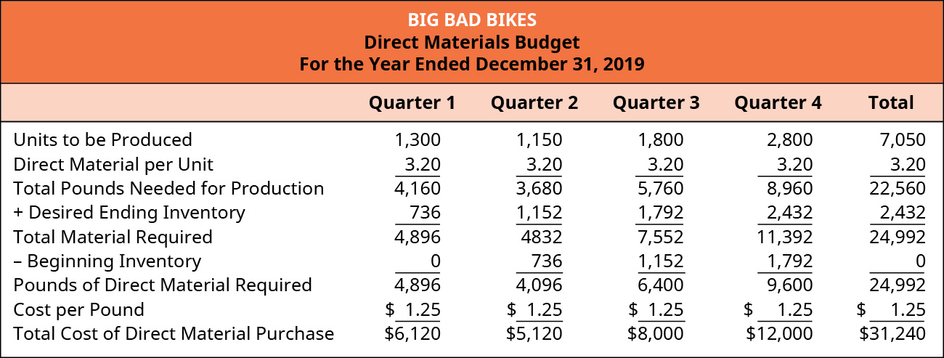
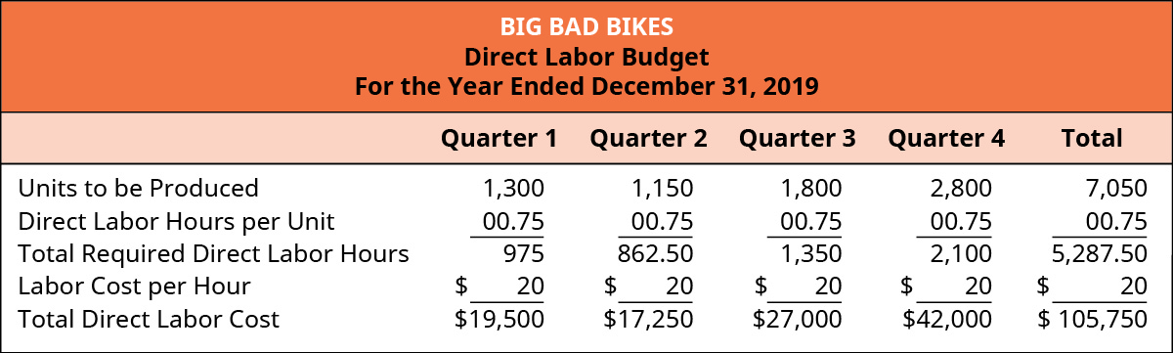
(Pound)

Slide 10
Manufacturing Overhead
Costs that support production but are not direct materials or direct labor are considered overhead.
Manufacturing overhead has three components:
Indirect materials (materials used in production but not traced to specific products because the net informational value from the time and effort to trace the cost to each individual product produced is impossible or inefficient)
Indirect labor (labor costs of those employees associated with the manufacturing process, but whose contributions are not directly traceable to the final product), and
Overhead (costs that are necessary for production but not efficient to assign to individual product production. Examples of typical overhead costs are production facility electricity, warehouse rent, and depreciation of equipment.)

Slide 11
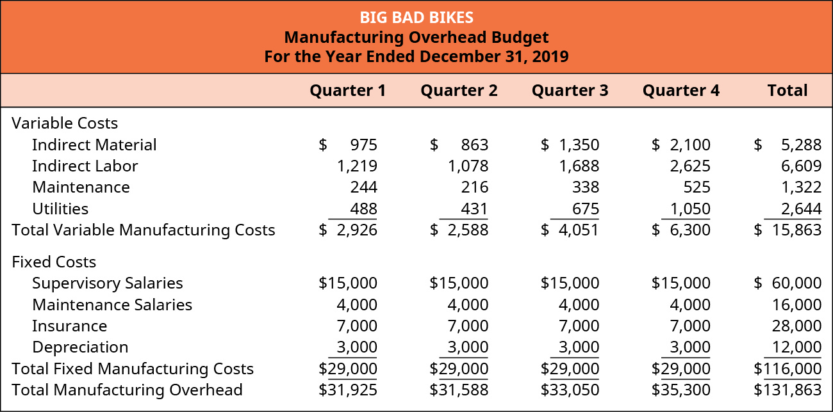
Prepare Operating Budgets:
Manufacturing overhead Budget
For Big Bad Bikes to create their MOH budget, they first determine that the appropriate driver for assigning overhead costs to products is direct labor hours (DLH). The overhead allocation rates for the variable overhead costs are:
Indirect material of $1.00 per DLH
Indirect labor of $1.25 per DLH
Maintenance of $0.25 per DLH, and
Utilities of $0.50 per DLH
The fixed overhead costs per quarter are:
Supervisor salaries of $15,000
Fixed maintenance salaries of $4,000
Insurance of $7,000, and
Depreciation expenses of $3,000.

Slide 12
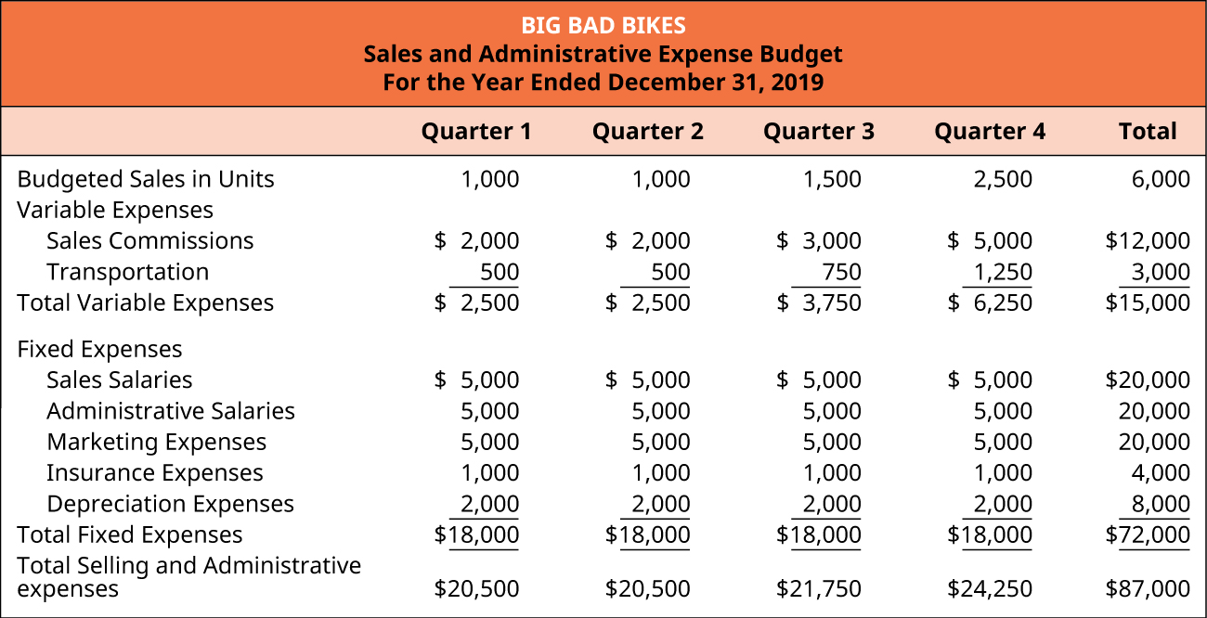

Slide 13
Prepare Budgeted Income Statement

Slide 14
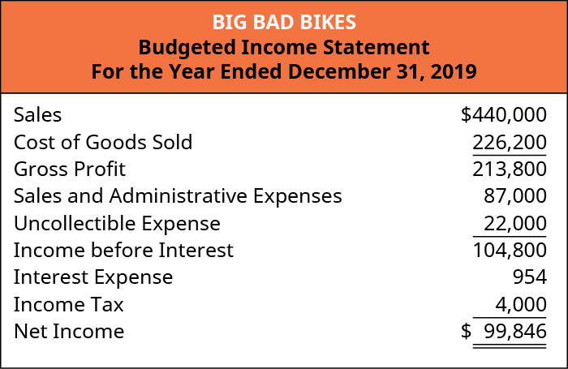

Slide 16
?

Slide 17
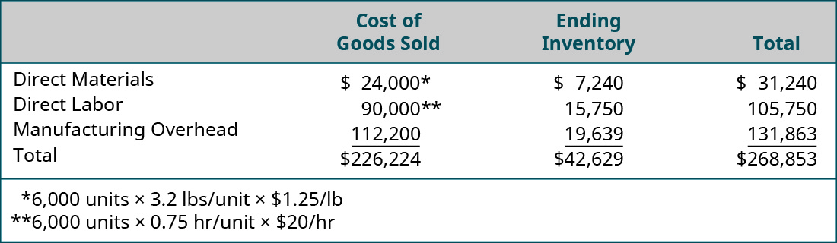
?

Slide 18
?

Slide 19
?

Slide 20
?
Total MFG OH cost = $131,863
# units produced = 7,050
MFG OH per unit = $18.70
# of units sold = 6,000
MFG OH = $112,224 (expensed as part of COGS)
# of units unsold (remaining in EI) = 6,000
MFG OH for EI = $112_____________,224

Slide 22
Prepare Financial Budgets

Slide 23
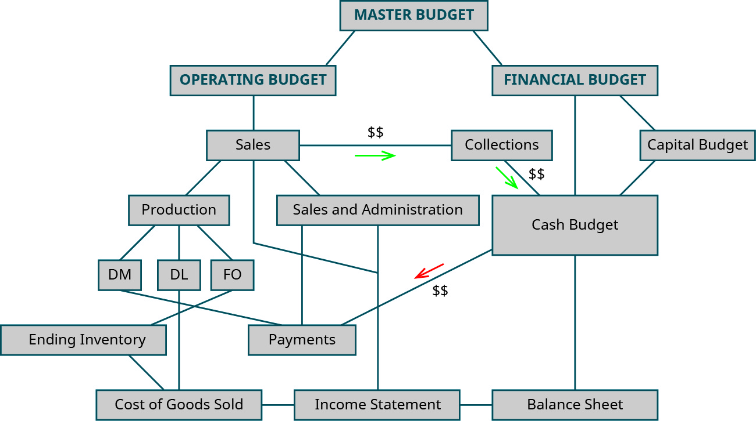
Relationship between Budgets

Slide 24
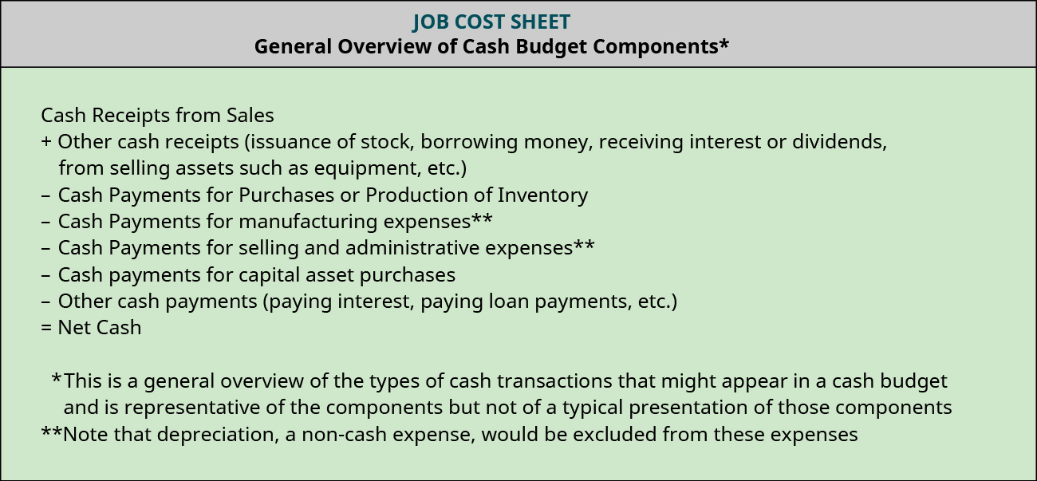

Slide 25
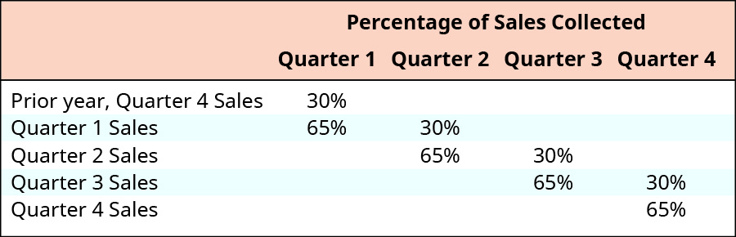
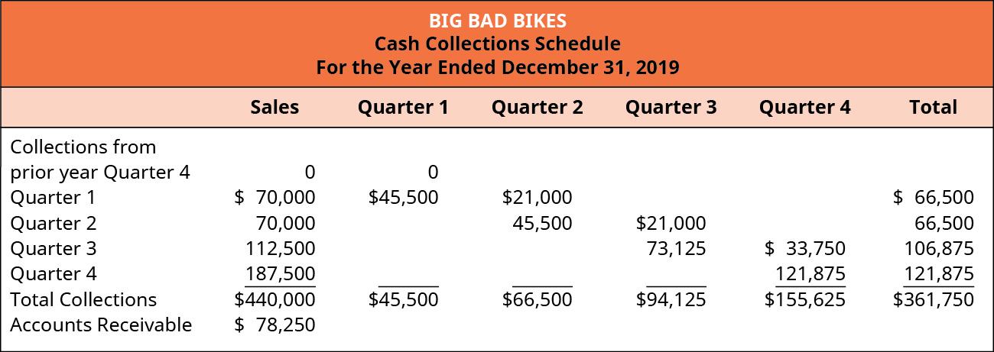

Slide 26
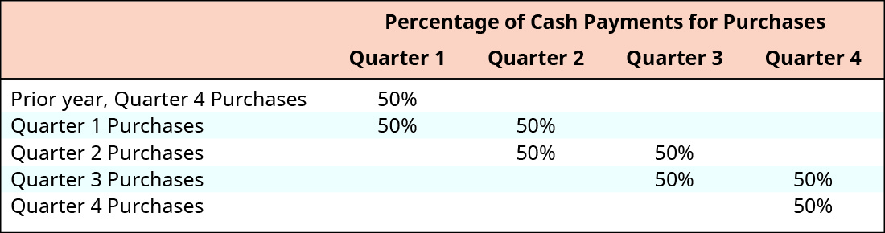
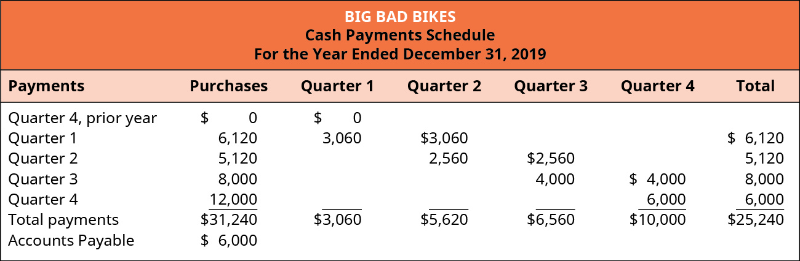

Slide 27
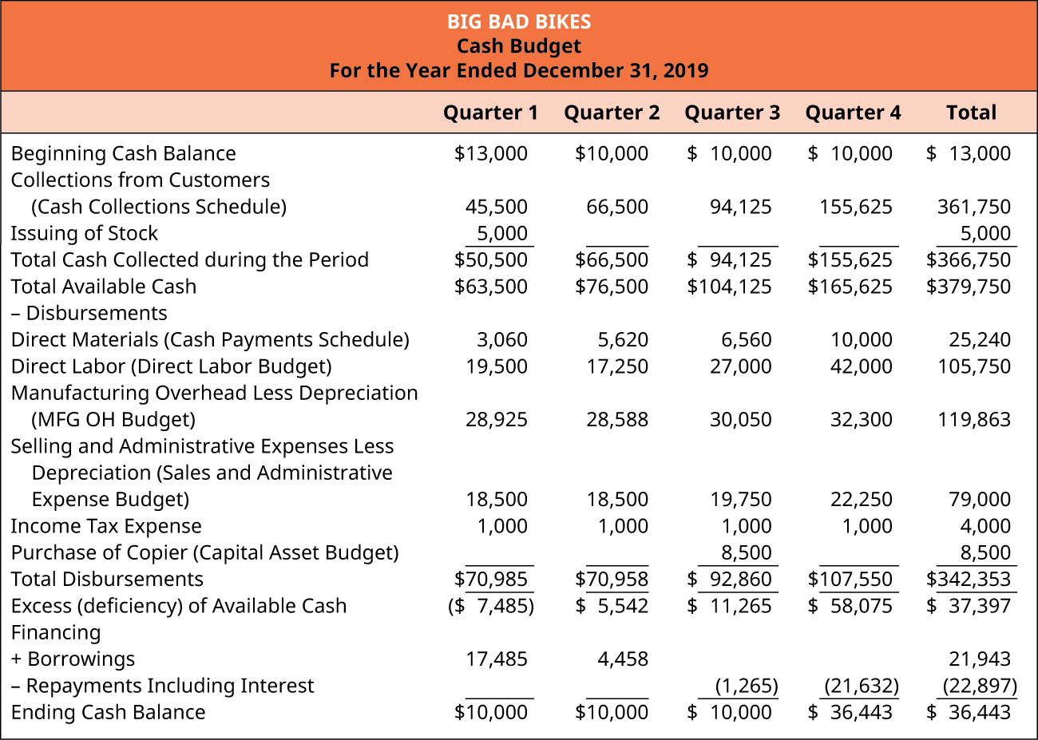

Slide 46
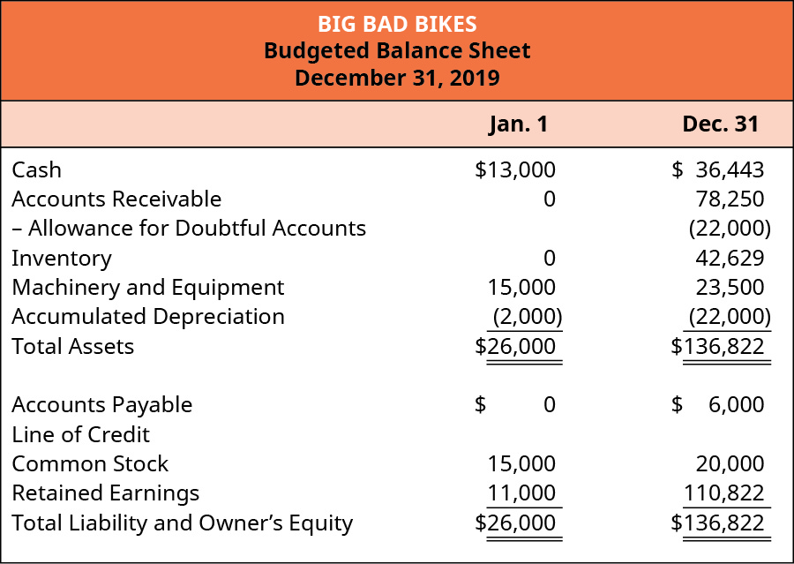

Slide 47
Review/Summary
Prepare Operating Budgets
The _____ budget is the first budget developed, and the estimated sales in turn guide the ___________ budget.
The production budget shows the quantity of goods produced for each time period and leads to computing when and how much _______ ___________ needs to be ordered, when and how much ______ needs to be scheduled, and when and how much manufacturing overhead needs to be planned.
The sales and administrative budget plans for the _________________ expenses.
All operating budgets combine to develop the budgeted ___________ statement.
Prepare Financial Budgets
The financial budget include the ____________ budget and the _____ budget.
The cash ________ schedule and cash _______ schedule are computed and combined with other budgets to develop the cash budget.
Information from financial budgets and the budgeted income statement are used to develop the budgeted _____________.
Budgets Are Used to Evaluate Goals
Management’s evaluations of ________ results versus the estimated __________results help assess performance and plan for the future.

Slide 48
INFO 7225 Module 2
Managerial Accounting
(8. Standard Costs & Variance Analysis)
Professor Shiaoming Shi
College of Engineering
Northeastern University

Slide 49
Standard Costs and Variance Analysis

Slide 50
What is the difference between a budget and a standard?
A budget usually refers to a company’s _____________ for costs, revenues, and cash flows associated with the overall operations of the organization, or a subsection of the corporation such as a division.
A standard usually refers to a company’s projected costs for ____________ of a product or service and includes the expected (or standard) cost for the various cost components of each unit, such as materials, labor, and overhead.
Standard costs provide information that is useful in _______________________. Standard costs are compared to actual costs, and ___________ between the two are termed variances. Favorable variances result when actual costs are _______ than standard costs, and vice versa.

Slide 51
Favorable and Unfavorable Variances
Actual Cost (AQ X AP)
Standard Cost (SQ X SP)
Standard Cost (SQ X SP)
Actual Cost (AQ X AP)
AQ, “actual quantity” of input used to produce the output
AP, “actual price” of the input used to produce the output
SQ and SP refer to the “standard” quantity and price

Slide 52
Example 1. Developing a Standard Cost Card
Use the information provided to create a standard cost card for production of one deluxe bicycle from Bicycles Unlimited.
To make one bicycle it takes four pounds of material. The material can usually be purchased for $5.25 per pound. The labor necessary to build a bicycle consists of two types. The first type of labor is assembly, which takes 2.75 hours. These workers are paid $11.00 per hour. The second type of labor is finishing, which takes 4 hours. These workers are paid $15.00 per hour. Overhead is applied using labor hours. The variable overhead rate is $5.00 per labor hour. The fixed overhead rate is $3.00 per hour.
STANDARD COST CARD
Product:
Manufacturing Information | Standard Quantity | Standard Price | Cost Summary
Direct Materials (per unit)
Direct Labor (per unit)
Manufacturing Overhead
Variable Overhead
Fixed Overhead
Standard Cost per Bicycle

Slide 53
Variance Analysis
Direct Materials Variances
Total Variance =
Direct Labor Variances
Total Variance =

Slide 54
Example 2. Compute Materials Variances
Biglow Company makes a hair shampoo called Sweet and Fresh. Each bottle has a standard material cost of 8 ounces at $0.85 per ounce. During May, Biglow manufactured 11,000 bottles. They bought 89,000 ounces of material at a cost of $74,760. All 89,000 ounces were used to make the 11,000 bottles. Calculate the total variance, material price variance, and the material quantity variance.

Slide 55
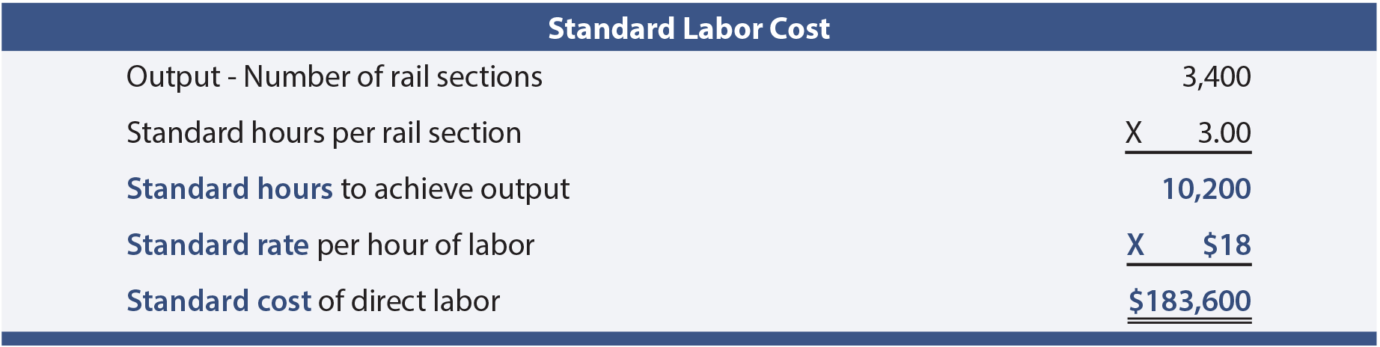
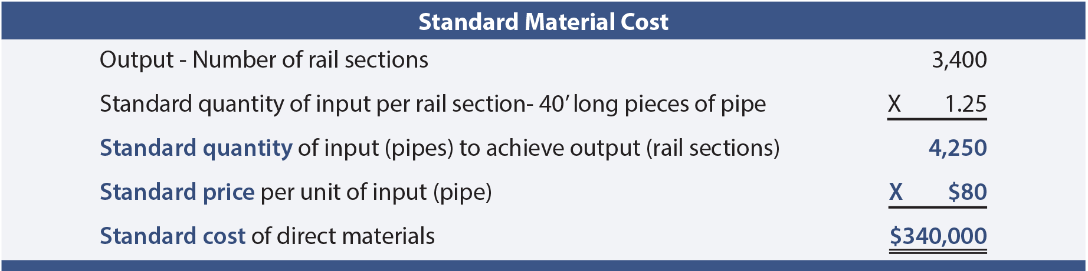
Example 3a.
Actual Material Cost
Actual quantity of input 4,100
Actual price per unit of input x $90
Actual cost of direct materials $369,000

Slide 56
Example 3b.
Actual Labor Cost
Actual hours of labor 12,500
Actual rate per hour x $14
Actual cost of direct labor $175,000

Slide 57
Factory (Manufacturing) Overhead Variances
Overhead has both variable and fixed components (unlike direct labor and direct material that are exclusively variable in nature).
The variable components may consist of items like indirect material, indirect labor, and factory supplies.
Fixed factory overhead might include rent, depreciation, insurance, maintenance, and so forth.
Because variable and fixed costs behave in a completely different manner, it stands to reason that proper evaluation of variances between expected and actual overhead costs must take into account the intrinsic cost behavior.
As a result, variance analysis for overhead is split between variances related to variable overhead and variances related to fixed overhead.

Slide 58
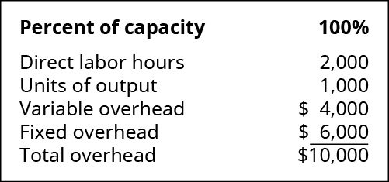
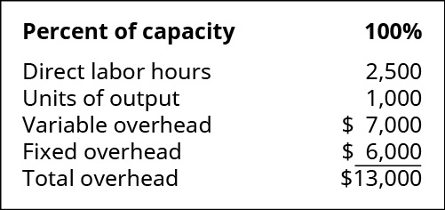
Variance Analysis
Variable Overhead (VOH) Variances
Total Variance =
Example 4a
Budget data: Actual output information:
Std VOH rate = Actual VOH rate =

Slide 59
 | Budgeted | Actual
Example 4b:
Fixed overhead
Production volume (unit)
Direct labor hours (hours/unit)
Fixed overhead (FOH) allocation rate
FOH allocated to WIP inventory =
FOH volume variance =
FOH spending variance =

Slide 60
Summary/Review
Standard Costs and Variances
Standards are budgeted unit amounts for price paid and amount used.
Variances are the difference between actual and standard amounts.
Variance can be favorable or unfavorable.
Direct Labor Variances
Two components: direct labor rate variance and direct labor time (efficiency) variance.
Rate paid vs. standard rate
Actual hours vs. standard/budgeted hours
Manufacturing/Factory OH Variances
Two set of OH variances: variable and fixed
The variable variances are caused by the overhead application rate and the activity level against which the rate was applied.
There are two fixed overhead variances. One is caused by spending two much or too little on fixed overhead. The other is caused by actual production being above or below the expected production level.
Direct Materials Variances
Two components: direct materials price variance and direct materials quantity variance.
The direct materials price variance is caused by paying too much or too little for material.
The direct materials quantity variance is caused by using too much or too little material.

Slide 61
Thank you!
Questions?

